Slide 1
Financial Planning:
Savings, Investments

Slide 2
INTRODUCTION
Benefits of being more financially literate
Control your financial future.
Achieve your life goals.
Provide for yourself and your family.
Be a smarter consumer.
Reduce stress and sleep better at night.
1

Slide 3
INTRODUCTION
The current average percentage of their income that Canadians save is:
2.6%
7.5%
10%
2

Slide 4
INTRODUCTION
In 2017, the average household debt of Canadians was:
$26,000
$56,000
$158,000
3

Slide 5
INTRODUCTION
In 2016, the total reported dollar loss by victims of identity theft in Canada was about:
$7 million
$9 million
$11.7 million
4

Slide 6
INTRODUCTION
In 2009-2010, the average debt:
For college graduates was:
$3,500
$8,500
$14,900
For a university graduates was:
$11,500
$26,000
$32,500
5

Slide 7
INTRODUCTION
The percentage of Canadian youth whose parents are not expected to contribute any savings to their education after high school is:
25%
35%
40%
6

Slide 8
SAVING AND INVESTING

Slide 9
SAVING AND INVESTING
Why save for the future?
Feel more secure and in control.
Be prepared for emergencies.
Reduce stress and conflict.
Spend with less guilt or fear.
Afford major purchases.
Pay off debt and avoid new debt.
Retire comfortably.
8

Slide 10
SAVING AND INVESTING
Make your goals specific
Set a dollar amount and deadline.
Break your goal into smaller goals.
Write down your goal and post it where you can see it every day.
9

Slide 11
SAVING AND INVESTING
Savings
Set up an emergency fund.
Pay yourself first.
Make savings automatic.
Grow your savings.
10

Slide 12
SAVING AND INVESTING
Make your savings automatic
Set up direct debits from your bank account or paycheque.
Save 5% to 10% of your take-home pay.
If you earn $2,000 a month after tax:
Saving 5 percent = $100 a month = $1,200 a year.
Saving 10 percent = $200 a month = $2,400 a year.
Extra money (from gifts, tax refunds, etc.) or a raise? Save it.
11

Slide 13
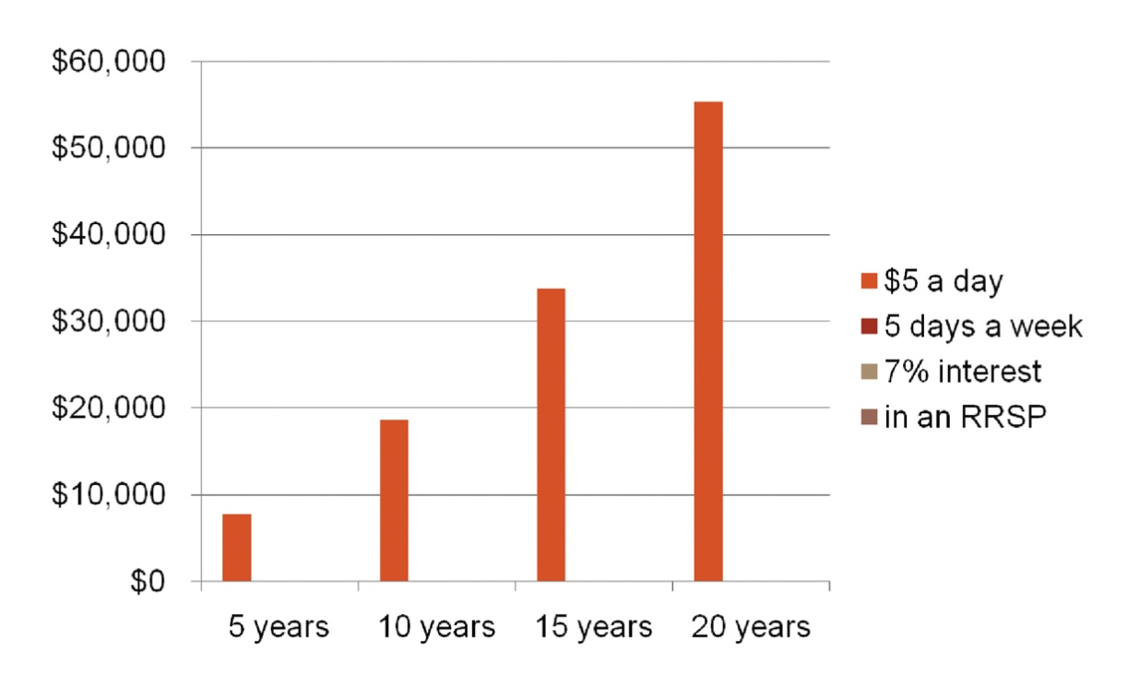
SAVING AND INVESTING
Compounding makes your money grow
12

Slide 14
SAVING AND INVESTING
13
Actions | Amy | Amanda
Starts saving at: | 20 | 30
Puts $1,000 a year into her RRSP to age: | 34 | 64
Total she saved: | $15,000 | $35,000

Slide 15
SAVING AND INVESTING
14
Actions | Amy | Amanda
Total she earns at age 65: | $141,700 | $116,100
Conclusion:
Start saving as soon as possible (the sooner the better)
Save as long as you can (for a long period of time)

Slide 16
SAVING AND INVESTING
Rule of 72: Time it takes to double your money
15
Interest rate | Your money doubles in:
2% | 36 years
4% | 18 years
6% | 12 years
8% | 9 years
10% | 7.2 years
12% | 6 years

Slide 17
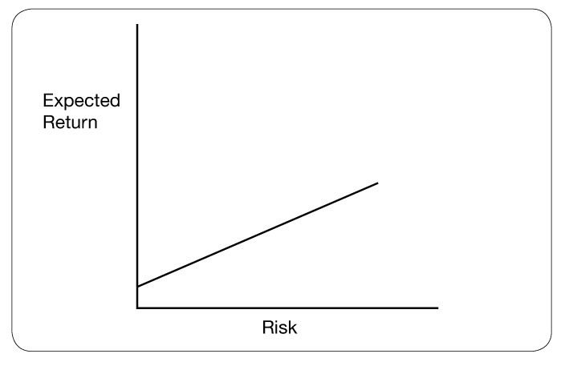
SAVING AND INVESTING
Risk and return
16

Slide 18
SAVING AND INVESTING
Four types of investments
Investments that pay interest (savings accounts, CSBs, GICs, etc.).
Shares in a company (stocks, mutual funds that invest in stocks, etc.).
Property (real estate, art, precious metals, etc.).
Direct investment in a business.
17

Slide 19
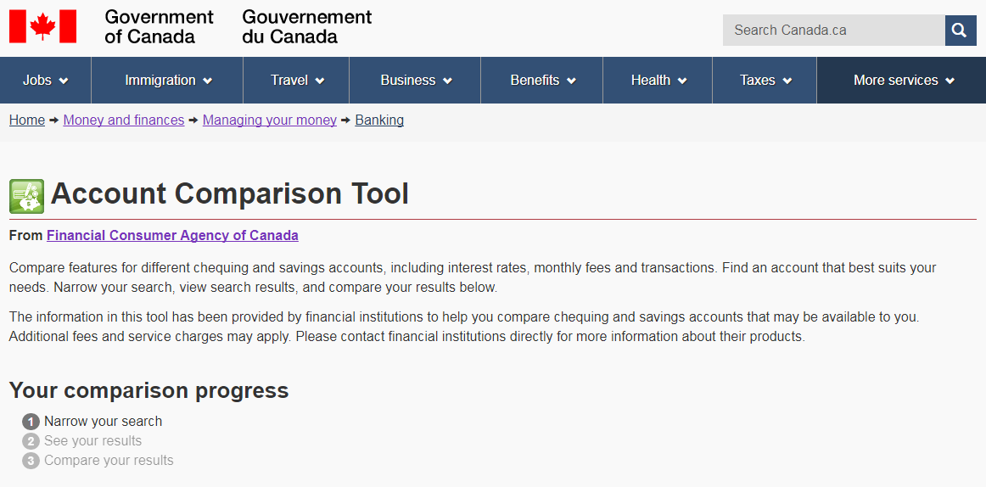
SAVING AND INVESTING
Account Comparison Tool
18

Slide 20
SAVING AND INVESTING
Canada Savings Bonds
Available from early October to December each year.
Opt for regular or compound interest.
Buy online, where you bank or invest, or at your workplace through payroll deduction.
Canada Savings Bonds:
Cashable any time, but no interest paid if cashed within first three months.
Canada Premium Bonds:
Cashable only once a year but pay more.
19

Slide 21
SAVING AND INVESTING
GICs
Your money is locked up for a period of time, ranging from less than 1 month to 10 years.
Generally, the longer the term, the higher the rate of interest.
Traditional GICs: principal and return are guaranteed.
“Market-linked” GICs: principal is guaranteed, but returns are linked to a stock market index, so they fluctuate.
You can also get cashable GICs, which are more flexible but have lower rates.
20

Slide 22
SAVING AND INVESTING
Stocks
Shares in a company; you are partial owner of the company.
Share prices and returns can be positive or negative.
No guarantee of income: you could lose your whole investment.
Traded on stock exchanges or over-the-counter markets.
Stocks have outperformed other investment options by a wide margin over periods of 10 years or more – but they are not guaranteed. They can lose value.
21

Slide 23
SAVING AND INVESTING
Why invest in mutual funds?
Professional management.
Diversification: your money is spread over several investments.
Ease of access: you can generally sell any time.
Readily available through most financial institutions.
22

Slide 24
SAVING AND INVESTING
Questions to ask a prospective financial advisor
What is your background, experience and track record?
Is your firm registered with a securities commission or other formal body?
What can you do for me? Provide advice only, sell products, help me build a financial plan?
What products do you sell?
How do you get paid?
How do you work with your clients?
Can you provide references?
23

Slide 25
SAVING AND INVESTING
The three knows
Know yourself: your investment goals and timeline, your risk tolerance.
Know your investment: is it right for you?
Know your advisor.
24

Slide 26
SAVING AND INVESTING
Registered tax plans
Tax-Free Savings Accounts (TFSAs): earn income from investments without paying taxes on the income
Registered Retirement Savings Plans (RRSPs): defer paying income tax until retirement
Registered Education Savings Plans (RESPs): shift the tax to a student
Registered Disability Savings Plans (RDSPs): shift the tax to someone with a disability
25

Slide 27
FINANCIAL PLANNING

Slide 28
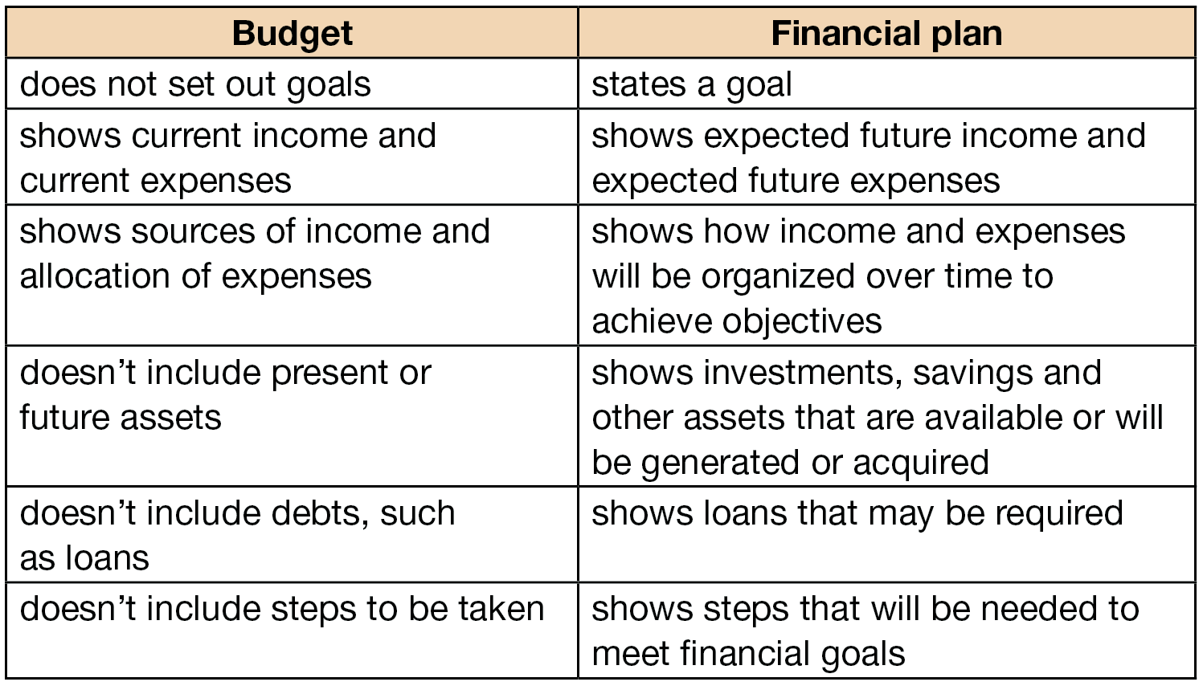
FINANCIAL PLANNING
Budget and financial plan
27

Slide 29
FINANCIAL PLANNING
How can a financial plan help you?
Minimize your taxes.
Cover insurance needs.
Buy a home and pay off the mortgage quickly.
Fund your children’s education.
Optimize employee benefits and pensions.
Save and plan for retirement.
Fund long-term health issues.
Care for elderly parents.
Manage estate planning and how to transfer wealth in families.
28

Slide 30
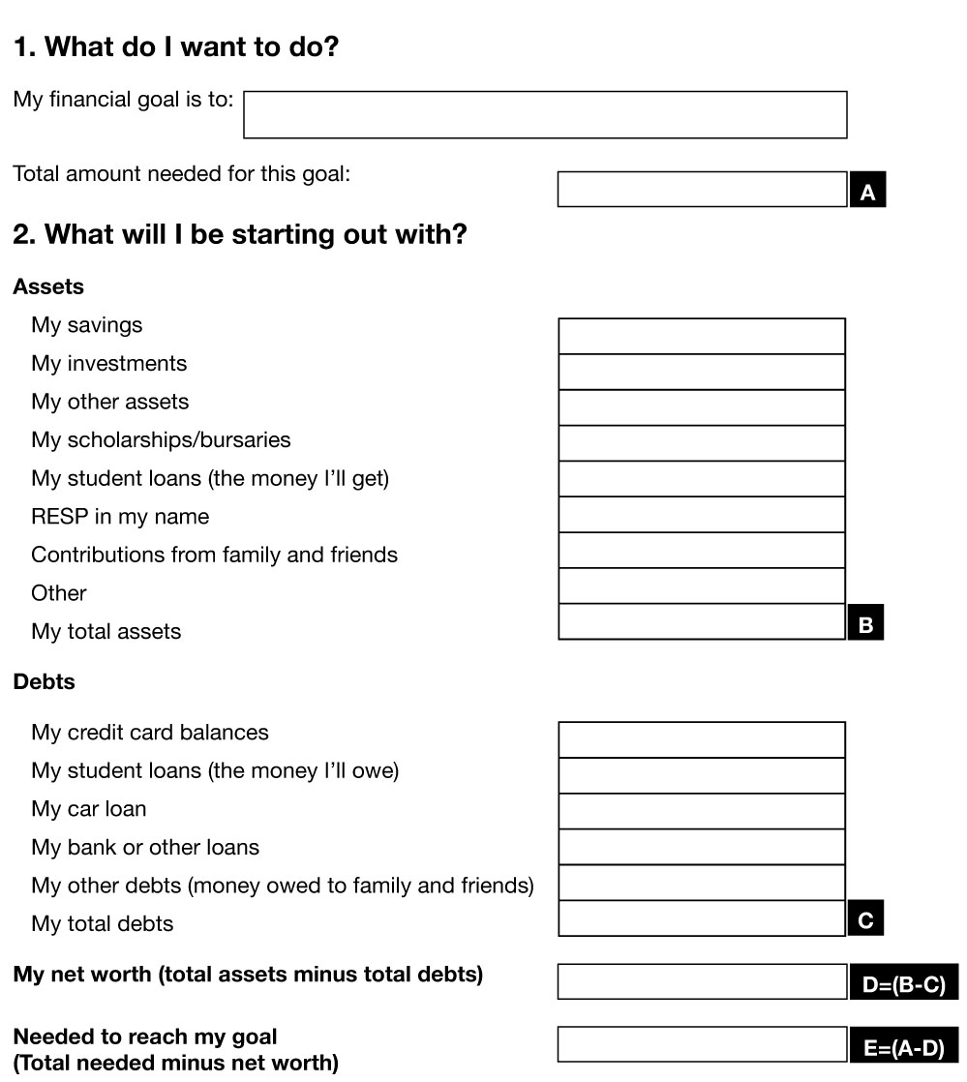
FINANCIAL PLANNING
29

Slide 31
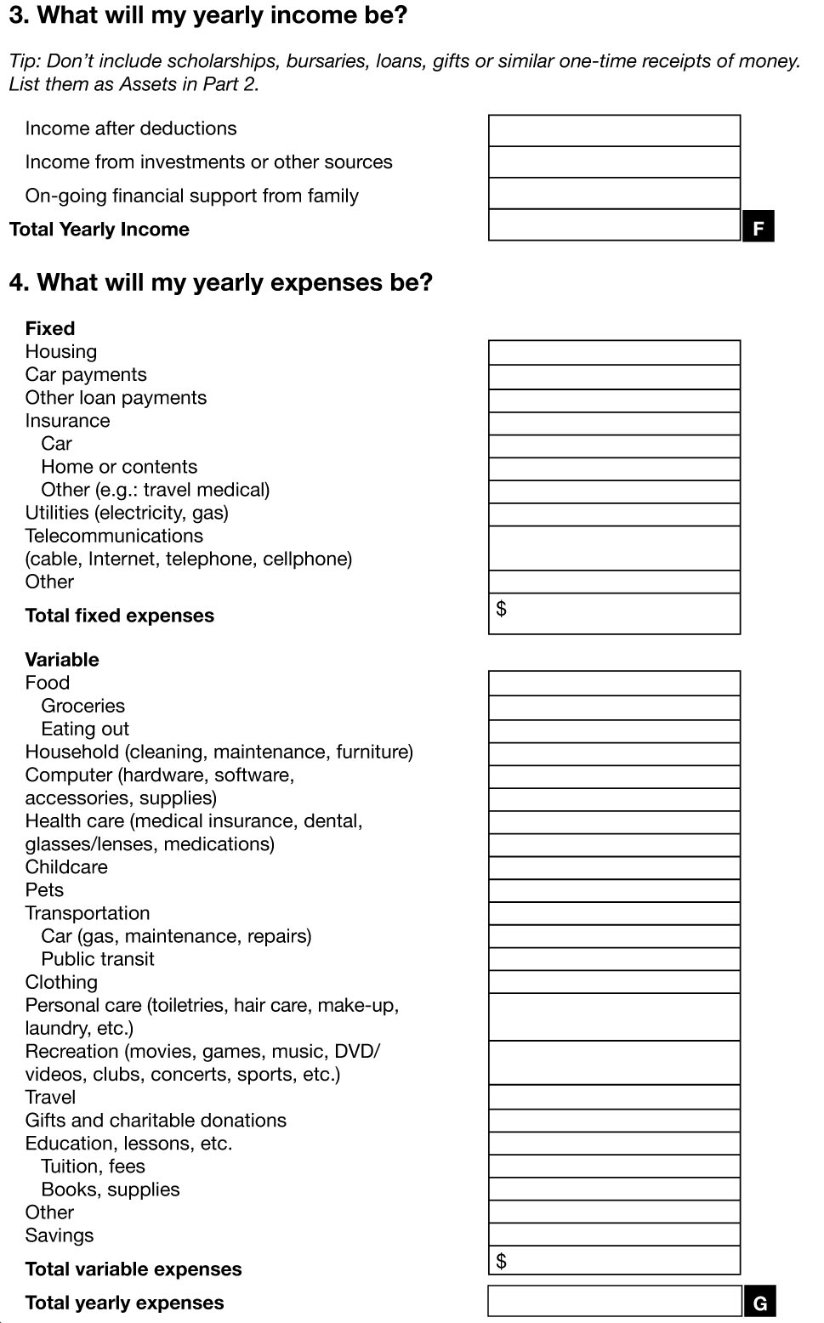
FINANCIAL PLANNING
30

Slide 32
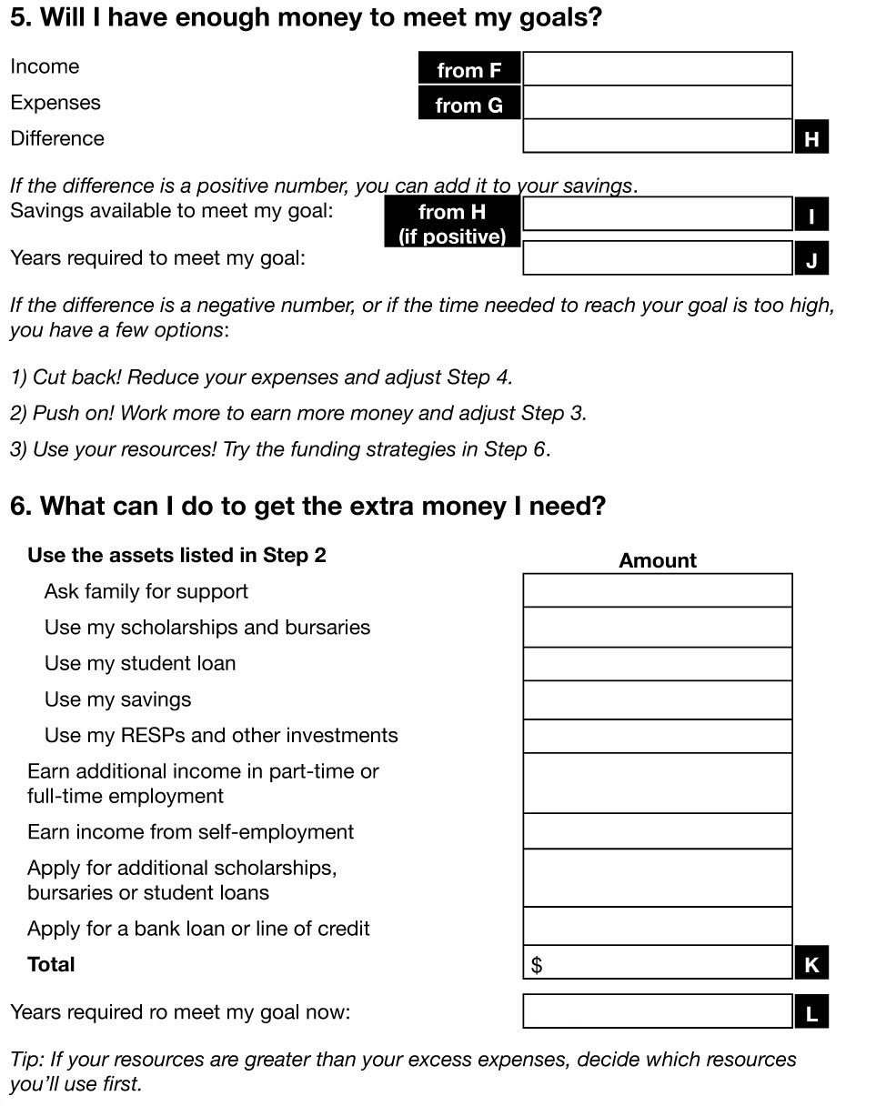
FINANCIAL PLANNING
31

Slide 33
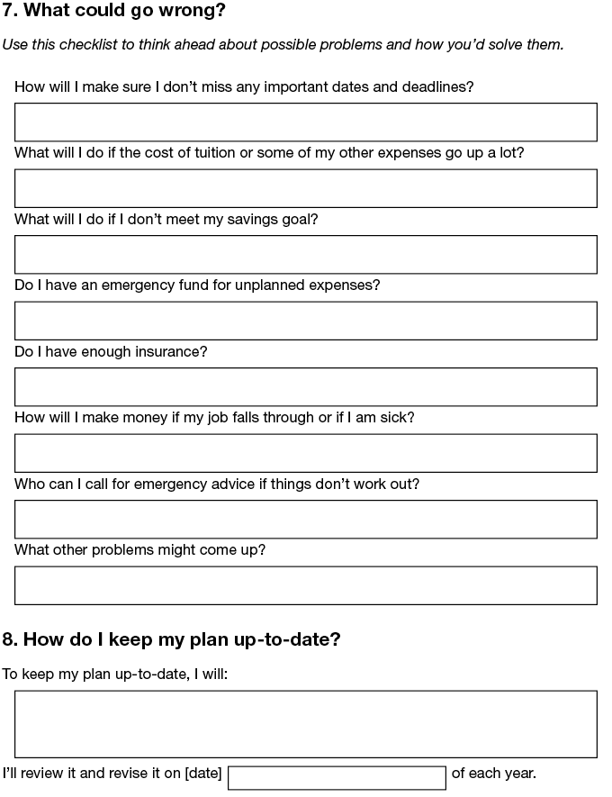
FINANCIAL PLANNING
32

Slide 34
SUMMARY AND WRAP-UP

Slide 35
SUMMARY AND WRAP-UP
Keep track of your income and your expenses in a budget.
Save money by questioning your bills and reducing your “latte factor.”
Pay yourself first with automatic savings.
Start an emergency fund.
Shop around for the best banking accounts, credit cards and service plans.
Pay all debts on time and in full, if possible.
Set clear savings goals.
Find a licensed financial advisor for long-term investment guidance.
Use RRSPs and TFSAs to let your savings grow tax-free.
Secure your identity and avoid identity theft.
What have we learned?
34

